Slide 1

A CROSS-PLATFORM BRAND ACTIVATION
East Meets Feed
Building @Yujia's Presence on Instagram · Douyin · Xiaohongshu
IG
Douyin
XHS
Eric Wang · Social Media & Brand · NYU · June 2026
01 / 10

Slide 2
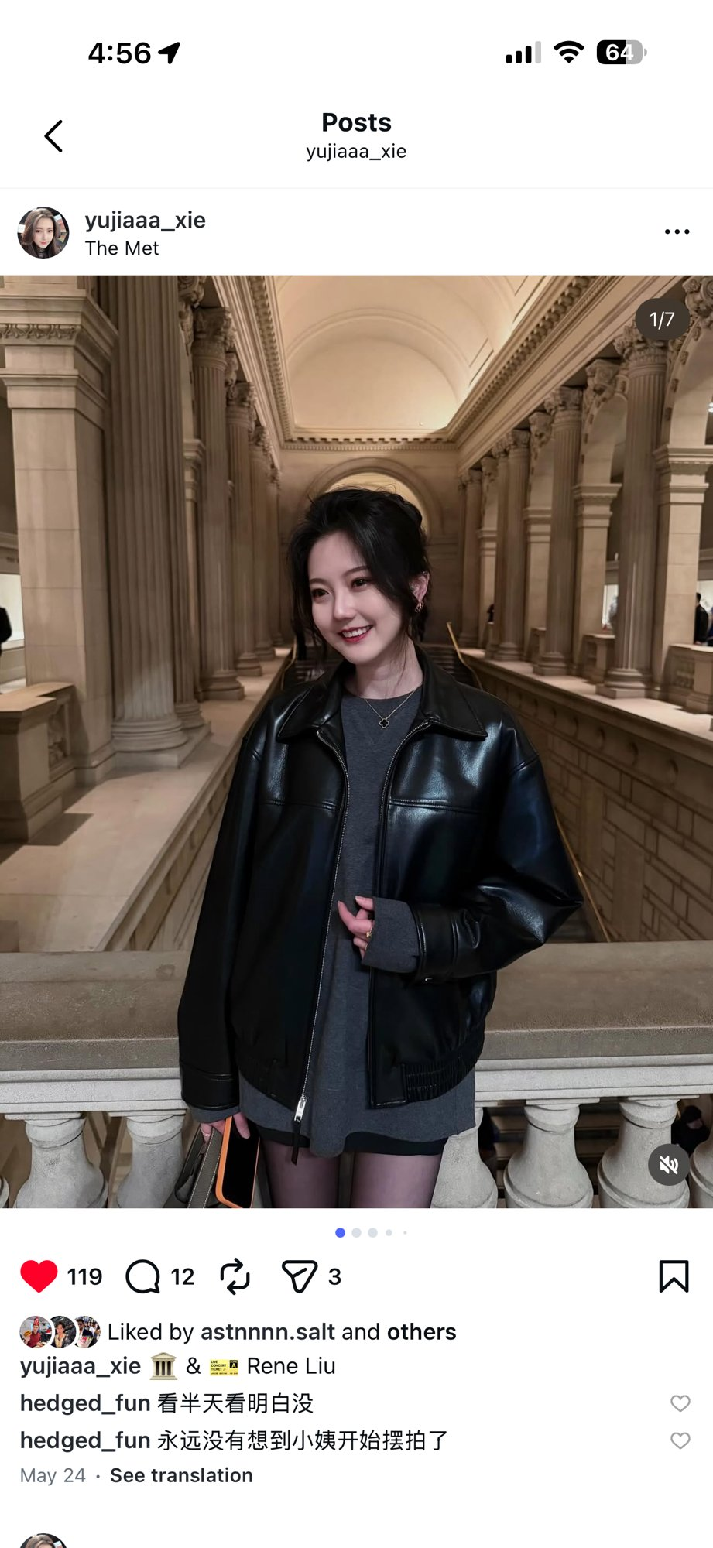
EAST MEETS FEED
02 / THE SUBJECT & WHY
She takes photos that deserve a bigger audience.
bigger audience.
WHO IS YUJIA
Yujia Xie — Data Engineer Tech Lead at CVS, NYC. B.S. Data Science, UCSD · M.S. Data Science, Columbia.
Lifestyle
Fashion
NYC
Cross-Cultural
THE OPPORTUNITY
2,900+ combined followers across three platforms — but no consistent strategy, no cross-posting, no growth system.
STRATEGIST · ACTIVATOR · PRODUCER
02 / 10

Slide 3
EAST MEETS FEED
03 / PLATFORM STRATEGY
One Creator. Three Platforms. One Brand.
Mapping @Yujia's content to the right audience on each platform
Instagram
Douyin
Xiaohongshu
@yujiaaa_xie
@Xyjjj
谢雨佳 · 小红书
AUDIENCE
AUDIENCE
AUDIENCE
English-speaking Western market · NYC creatives & lifestyle
Chinese diaspora + mainland China · algorithm-driven discovery
Chinese women · lifestyle & fashion discovery · aspiration-driven
CONTENT
CONTENT
CONTENT
Polished lifestyle photography · editorial fashion · cultural spaces
Emotional lifestyle · poetic captions · relatable slice-of-life
Curated photo posts · location tags · OOTD & cultural experiences
TONE
TONE
TONE
Aspirational · Quiet luxury · Authentic
Poetic · Resonant · Emotionally direct
Aspirational · Discovery-driven · Community
2,387 followers — strongest base
Highest viral upside
530 followers — high engagement
TARGET AUDIENCE
Women · Ages 24–35 · Lifestyle, Fashion & Culture
03 / 10

Slide 4
EAST MEETS FEED
04 / THE ACTIVATION
Content-First. Purely Organic.
STRATEGY PILLARS
PLATFORM EXECUTION
Pillar 1 — Aesthetic Visuals
Instagram @yujiaaa_xie
High-quality photography in iconic locations. Fashion-forward, editorial feel. Consistent visual identity across all platforms.
Photo carousels with music pairing. Fashion + lifestyle in NYC cultural spaces (The Met). Captions in English with cultural references.
Lifestyle
Fashion
Carousel
Pillar 2 — Resonant Captions
Poetic, introspective copy that invites emotional response — or open-ended questions that pull audiences into conversation.
Douyin @Xyjjj
Short-form videos with poetic, emotionally resonant Chinese captions. Aesthetic moments — art museums, quiet nights, candlelit scenes.
🚫 No Hashtags — Intentional
Emotional
Poetic
Short-form
Past experience showed hashtags yielded no meaningful reach. Phase 1: let content quality speak for itself.
Xiaohongshu 谢雨佳
Lifestyle notes with location context. Same visual assets cross-distributed from Instagram — NYC life as the hook for Chinese audiences.
95% Organic Distribution — no paid boosts, no promotions.
NYC Lifestyle
Cross-distributed
04 / 10

Slide 5
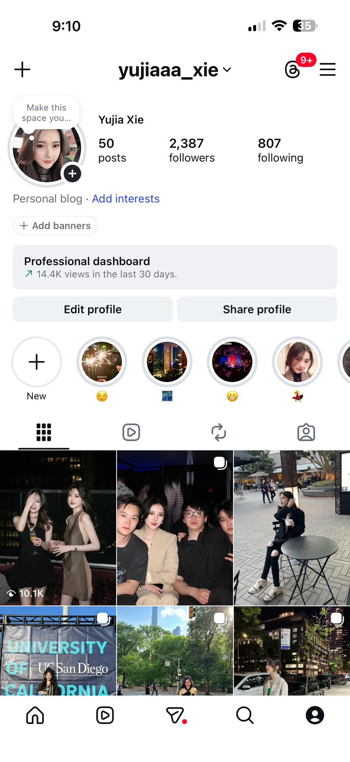
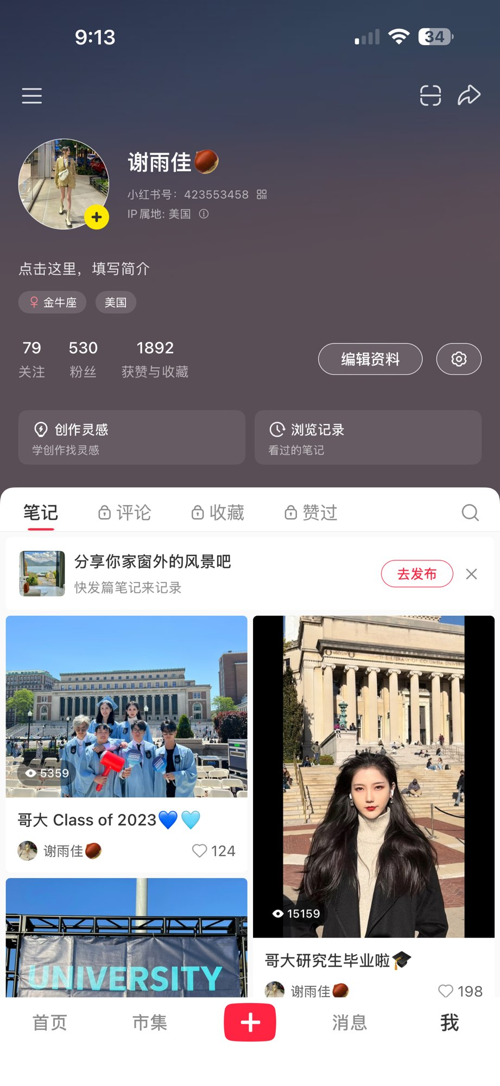
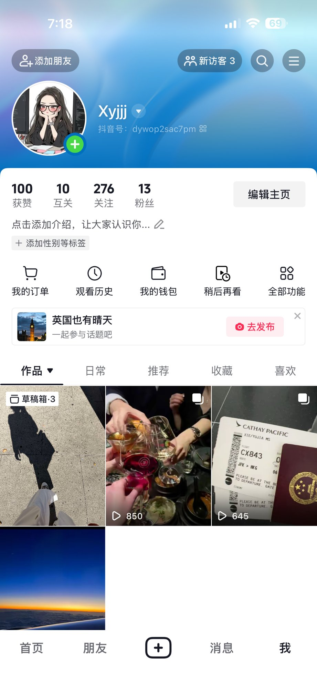
EAST MEETS FEED
05 / BEFORE ACTIVATION
Where We Started
Day 0 Snapshot — baseline metrics before any content was posted
Instagram
Xiaohongshu
Douyin
@yujiaaa_xie
谢雨佳 · 423553458
@Xyjjj
2,387
530
13
FOLLOWERS
FANS
FANS
22
1,892
100
INTERACTIONS / 30 DAYS
TOTAL LIKES & SAVES
TOTAL LIKES
Established — Low Activity
Dormant — No Recent Posts
Just Starting
05 / 10

Slide 6
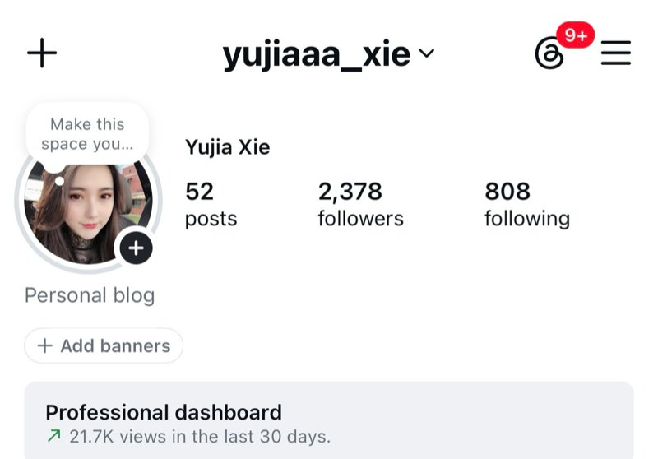

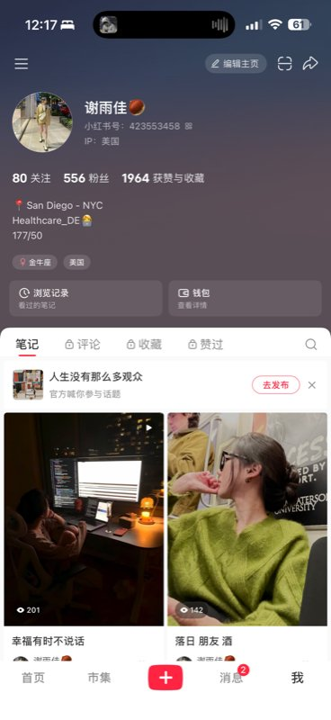
EAST MEETS FEED
06 / AFTER ACTIVATION
Growth Across All Three Platforms
Instagram
Xiaohongshu
Douyin
INTERACTIONS / 30D
FANS
FANS
22
→
207
+185
530
→
556
+26
13
→
267
+254
VIEWS / 30D
LIKES & SAVES
TOTAL LIKES
14.4K
→
21.7K
+51%
1,892
→
1,964
+72
100
→
1,643
+1,543
FOLLOWERS
TOP POST VIEWS
POSTS PUBLISHED
2,387
→
2,378
-9 cleaned
—
→
1,130
new
2
→
10
+8
TOTAL VALID KPIs — TARGET: 500
2,277
4.6× over target · in under 1 week
06 / 10

Slide 7

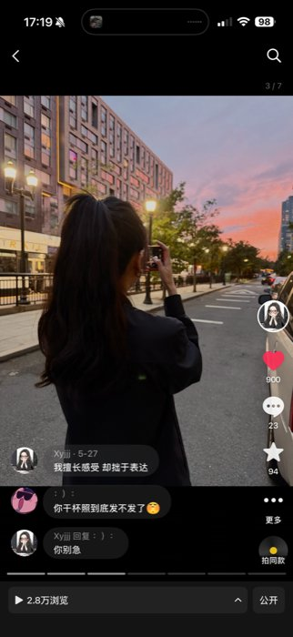
EAST MEETS FEED
07 / WHAT WORKED
Two Hero Posts. Two Platforms. One Strategy.
28K
PLAYS · HERO POST
DOUYIN @Xyjjj
我擅长感受 却拙于表达
I Feel Deeply, Struggle to Express
INSTAGRAM @yujiaaa_xie
900 Likes
23 Comments
94 Saves
+155 Followers
The Met Museum — NYC
Key insight: The same Met Museum shoot produced the #1 post on both Instagram and Xiaohongshu simultaneously — one creative execution, two platform wins. Quality of location + subject > quantity of posts.
Cultural space · editorial fashion · golden-hour light
110 Likes
12 Comments
2.7K Views
07 / 10
141 Profile Visits

Slide 8
EAST MEETS FEED
08 / WHAT DIDN'T WORK
Three Gaps. Three Lessons.
📉
🔍
🏷️
Douyin — Inconsistent Reach
Xiaohongshu — Discovery Gap
No-Hashtag Trade-off
Post 1 hit 24K plays. Posts 2 and 3 dropped to 3.4K and 1.5K respectively. The algorithm rewarded the emotional hook the first time — but follow-up content couldn't sustain that signal.
The Met post got 1,130 views and a 6.2% interaction rate — but Posts 2 and 3 collapsed to 144 and 201 views. Without hashtag strategy, Xiaohongshu's discovery layer didn't amplify past the first post.
The deliberate no-hashtag bet worked on Douyin (algorithm-driven) but limited reach on Xiaohongshu, where topic tags are the primary discovery mechanism. Pure organic content quality was not enough to beat the platform's tag-based feed.
Posts 2+3 avg: 2,421 plays vs 24K hero
Posts 2+3 avg: 172 views vs 1,130 hero
Phase 2 hypothesis: add 3–5 topic tags
ADJUSTMENT →
Phase 2: tighter emotional brief for Douyin consistency · topic hashtags on Xiaohongshu · replicate Met-style cultural shoots on Instagram
08 / 10

Slide 9
EAST MEETS FEED
VALID KPIs · LIKES + COMMENTS + SHARES + SAVES + NEW FOLLOWERS
2,277
4.6× over the 500-person target · in under 1 week
1,849
64
64
300
LIKES & SAVES
COMMENTS
SHARES
NEW FOLLOWERS
1,974
201
102
Douyin
Instagram
Xiaohongshu
86% of total
9% of total
5% of total
09 / 10

Slide 10
EAST MEETS FEED
10 / LEARNINGS
Four Insights That Will Shape Phase 2
01 — KEY LEARNING
02
Emotion > Aesthetics on Chinese Platforms
One Shoot = Three Audiences
Douyin's viral post succeeded not because of beautiful visuals — but because the caption "我擅长感受 却拙于表达" created emotional identification. Chinese platform audiences reward resonance over production quality. The algorithm follows the feeling.
The Met Museum shoot became the top post on both Instagram and Xiaohongshu simultaneously. Cross-platform repurposing isn't just efficient — it's strategic. The right shoot, edited for each platform's tone, compounds its own return.
03
04
Content Quality Beats Tactics
Platform Culture Shapes What Lands
No paid promotion. No hashtags. No collaborations. 2,277 KPIs came purely from posting the right content in the right emotional frame. Phase 1 confirmed: when content is strong enough, the platform works for you.
The same no-hashtag strategy worked on Douyin (algorithm-first) but failed on Xiaohongshu (tag-discovery-first). Understanding each platform's native discovery logic — not just its aesthetic — is the difference between 1,130 views and 144.
10 / 10

